Slide 1
Hotel Booking
Presenting Data Analysis

Slide 2


Agenda
A
Create a problem Statement
Identify the data to analyze
Explore and Clean the data
Analyze the data to get insights
Present the Data in term of reports and Visualization Dashboard

Slide 3
Business Problems
In recent years, City Hotel and Resort Hotel have seen high cancellation rates. Each hotel is now dealing with a number of issues as a result, including fewer revenues and less than ideal hotel room use. Consequently, lowering cancellation rates is both hotels primary goal in order to increase their efficiency in generating revenue, and for us to offer through business advice to address this problem.

Slide 4
Primary goals
To analysis of hotel booking cancellation as well as other factors that have no bearing on their business and yearly revenue generation are the main topics of this report.

Slide 5
Assumptions
No unusual occurrences between 2015 and 2017 will have a substantial impact on the data used.
The information is still current and can be used to analyze a hotel’s possible plans an efficient manner.
There are no unanticipated negatives to the hotel employing and advised techniques.
The hotels are not currently using any of the suggested solution.
The biggest factor affecting the effectiveness of earning income is booking cancellations.
Cancellation result in vacant rooms for the booking length of time.
Clients make hotel reservation the same year they make cancellation.

Slide 6
Research Questions
What are the variables that affect hotel reservation cancellations?
How can we make hotel reservations cancellation better?
How will hotel be assisted in making pricing and promotional decision?

Slide 7
Hypothesis
Hypothesis 1 : More cancellations occur when prices are higher.
Hypothesis 2 : When there is a longer waiting list, customers tend to cancel more frequently
Hypothesis 3 : The majority of clients are coming from offline travel ` agents to make their reservation

Slide 8
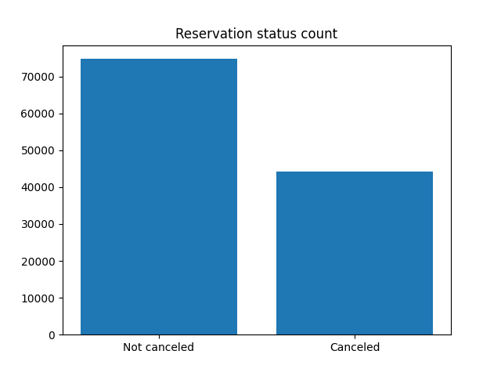
Analysis and Finding

Slide 9
Analysis And Finding
The accompanying bar graph shows the percentage of reservations that are canceled and those that are not. It is obvious that there are still a significant number of reservation that have not been canceled. There are still 37% of clients who canceled their reservation , which has a significant impact on the hotels’ earnings.

Slide 10
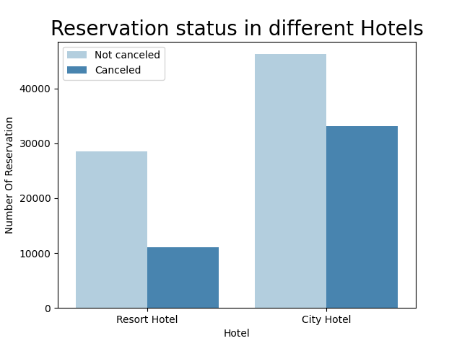
In comparison to resort hotels, city hotels have more bookings. It’s possible that resort hotels are more expansive than in cities

Slide 11
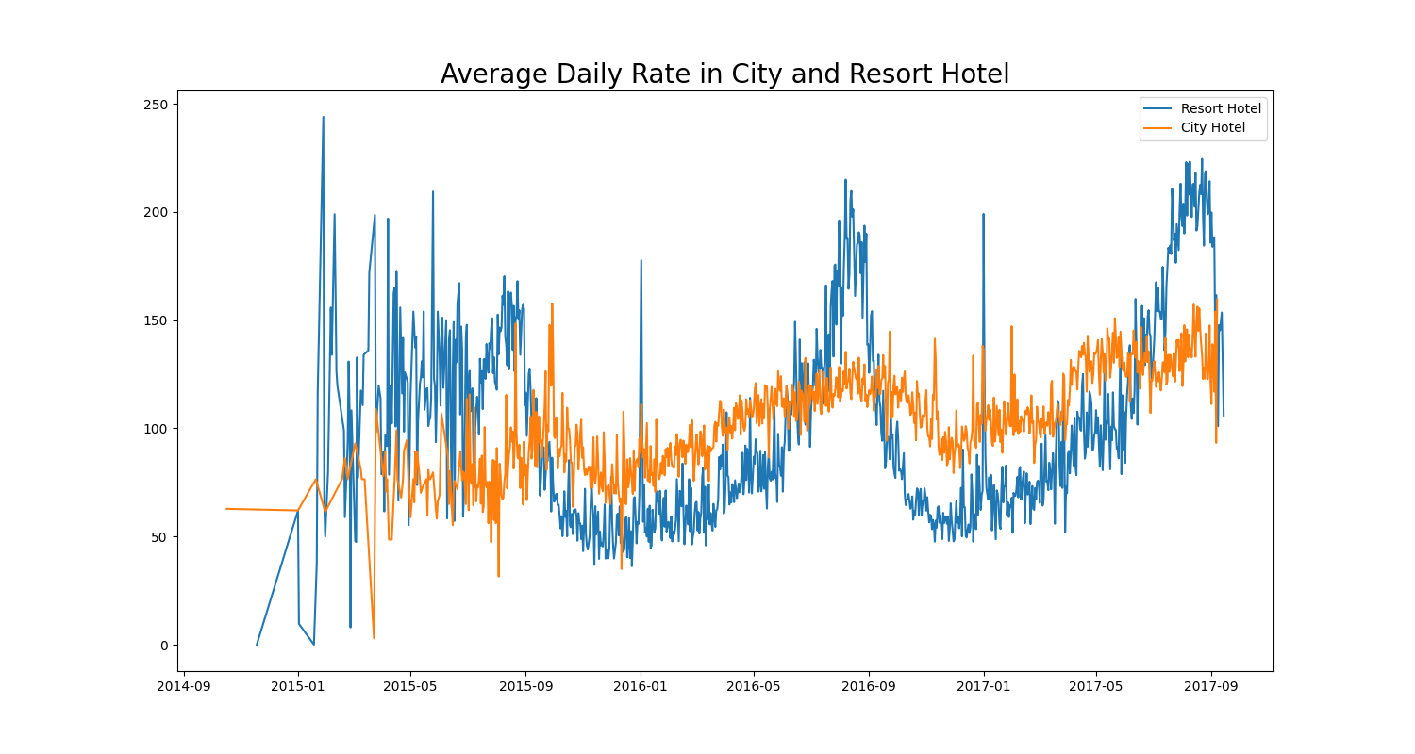
The line graph above shows that , on certain days, the average daily rate for a city hotel is less than that of a resort hotel, and on other days, it is even less. It goes without saying that weekends and holidays may see rise in resort hotel rates.

Slide 12
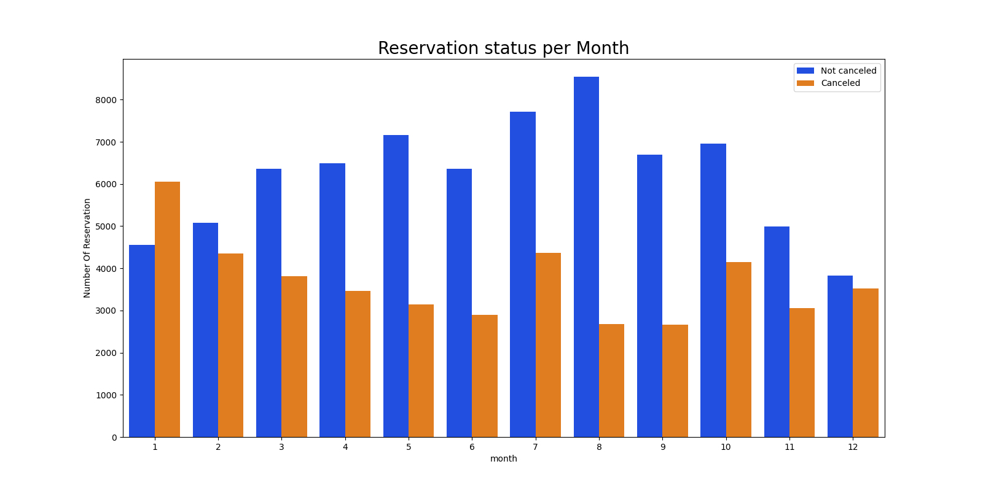
We have developed the grouped bar graph to analyze the month with the highest and lowest reservation levels according status. As can be seen , both the number of confirmed reservations and the number of cancelled reservations are largest in month of august . Whereas January is month with the most Cancelled reservation.

Slide 13
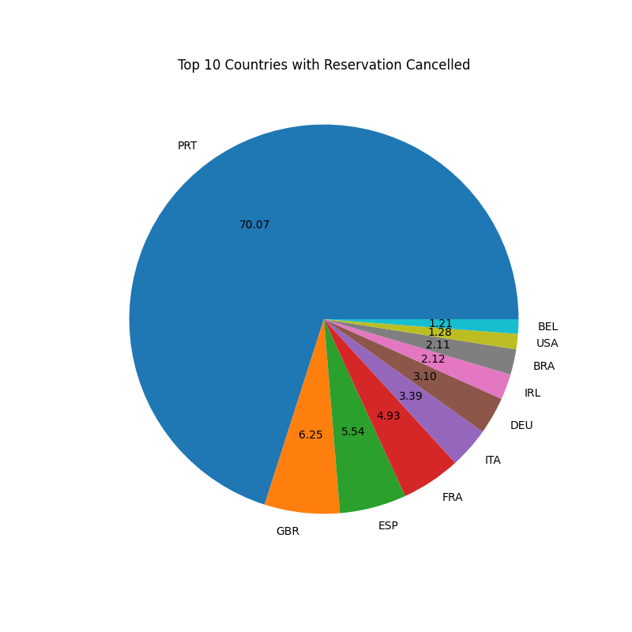
Now, let’s see which country has the highest reservation canceled, The top country is Portugal with highest number of cancellations.
Ley’s check the area from where guests are visiting the hotels and making reservations. Is it coming from Direct or groups. Online or offline Travel Agents? Around 46% of the clients come from online travel agencies, whereas 27% come from group. Only 45 od clients book hotel directly by visiting them and making reservations.

Slide 14
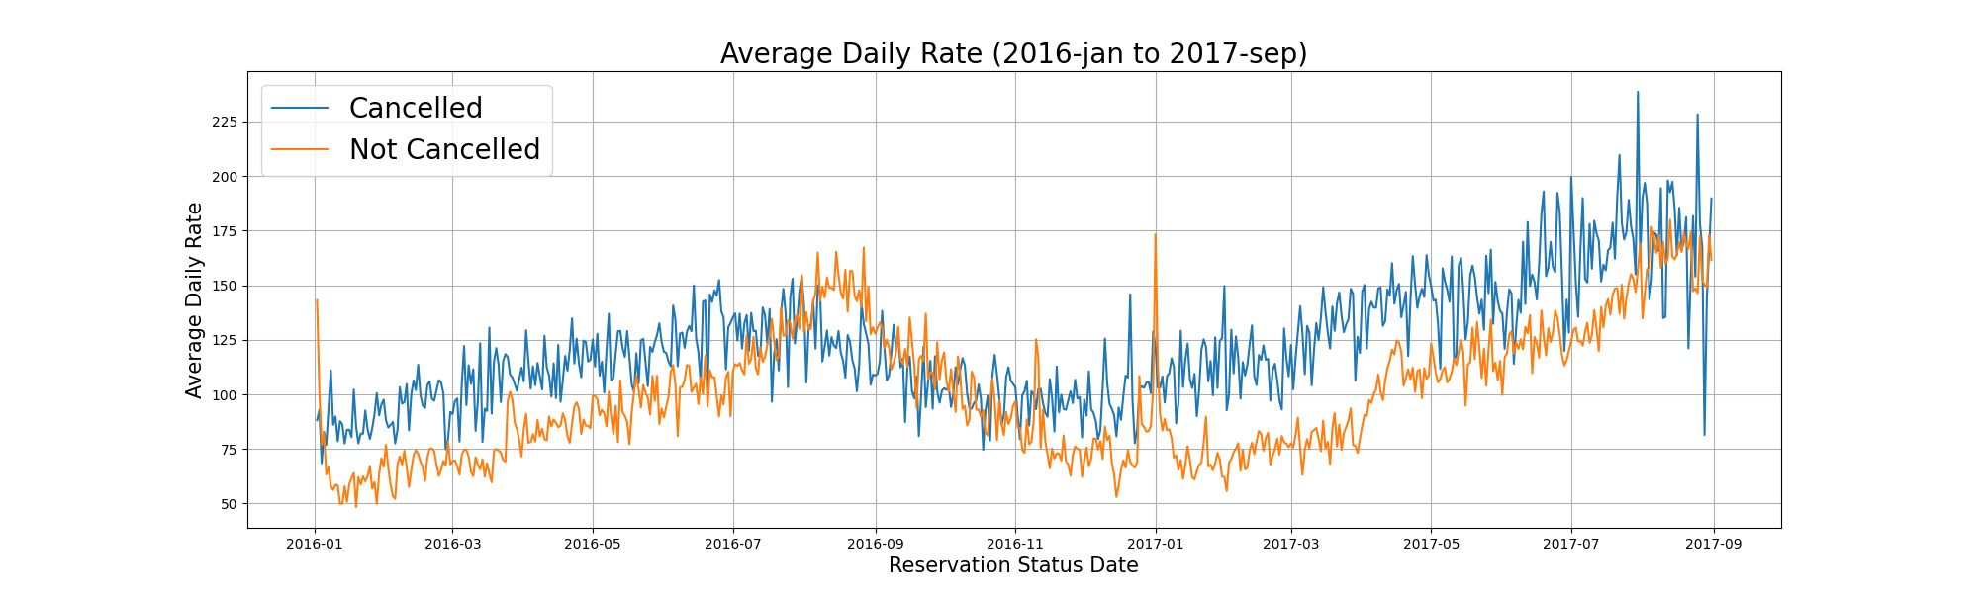
As seen in the Graph below , reservations are canceled when the average daily rate is higher than when it is not canceled. It clearly proves the all above analysis, that the higher price leads to higher cancellations.

Slide 15
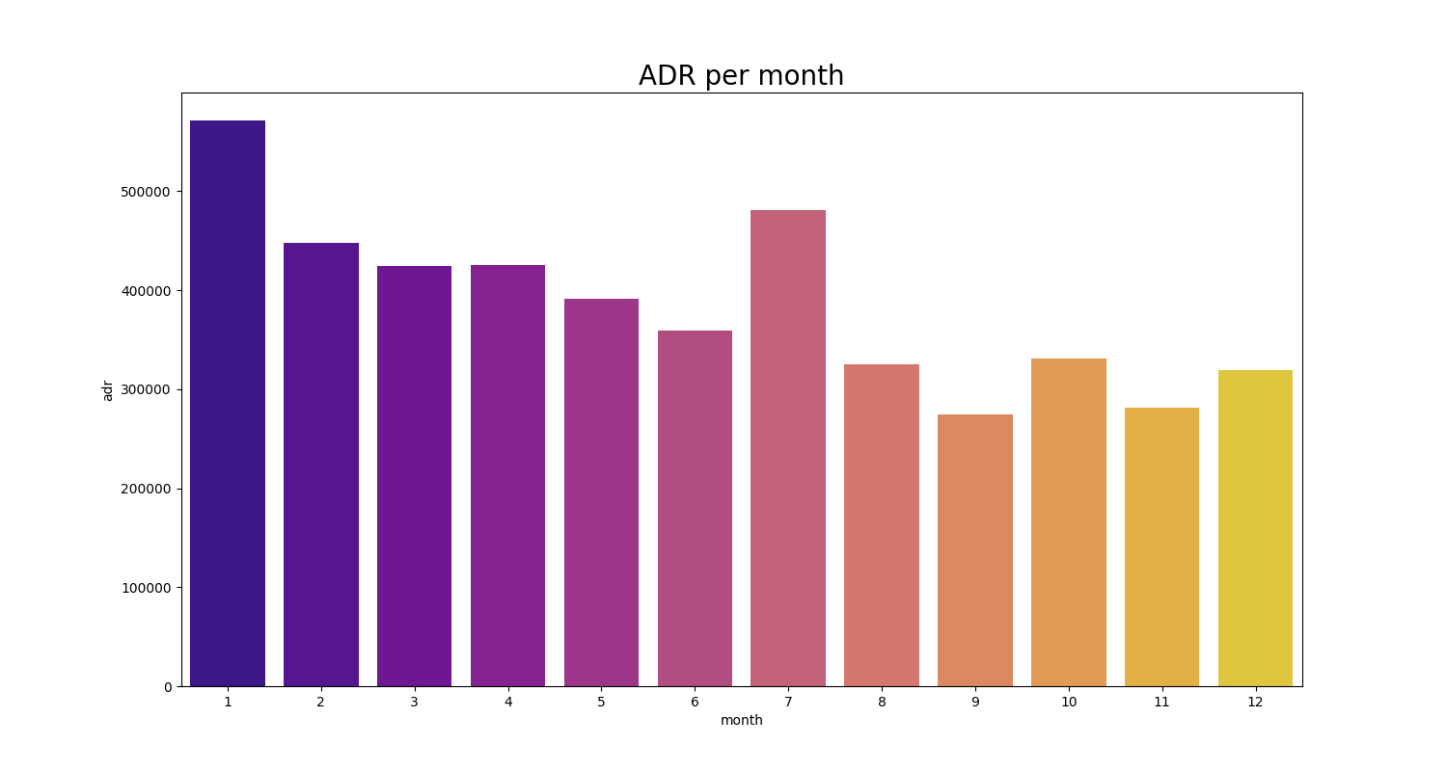
This bar graph demonstrate that are most common when process are greatest and are least common when they are lowest . Therefore, the cost of the accommodation is solely responsible for the cancellation.

Slide 16
Suggestions
S
Cancellation rates rise as the price does. In order to prevent cancellations of reservations, hotels could work on their pricing strategies and try to lower the rates for specific hotels based on locations. They can also provide some discounts to consumers.
As the ratio of the cancellation of the resort hotel is higher in the resort hotel than the city hotels. So, The hotels should provide a reasonable discount on the room process on weekends or on holidays.
They can increase the quality of their hotels and Their service mainly Portugal to reduce the cancellation rate

Slide 17
Thank you
Anjali Kumari
anjali290303@gmail.com

